Slide 1
Comparing EDMD approximation and ROA accuracy of different observable sets

Slide 2
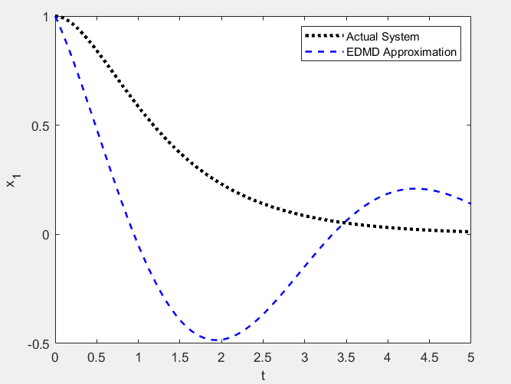
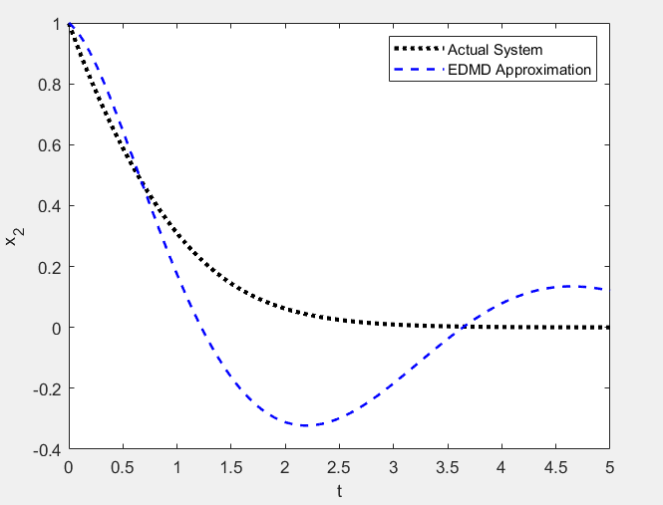
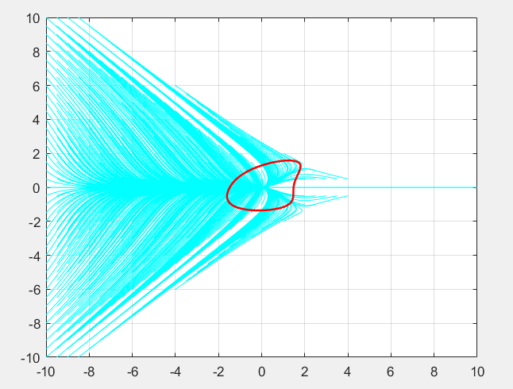
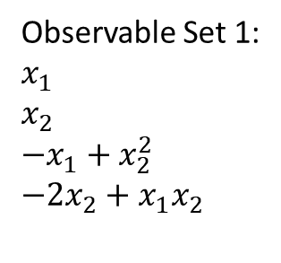
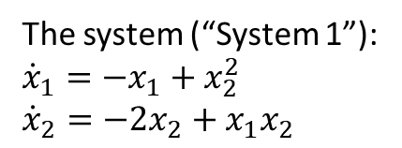
The system (“System 1”):
$${\dot{x}}_{1}=−x_{1}+x_{2}^{2}$$
$${\dot{x}}_{2}=−{2x}_{2}+x_{1}x_{2}$$
Observable Set 1:
$$x_{1}$$
$$x_{2}$$
$${−x}_{1}+x_{2}^{2}$$
$$−2x_{2}+x_{1}x_{2}$$

Slide 3
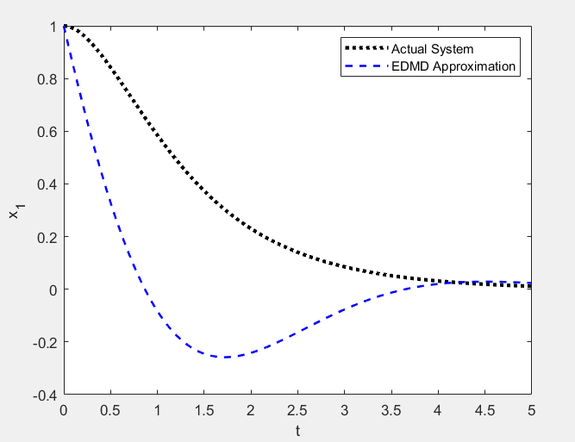
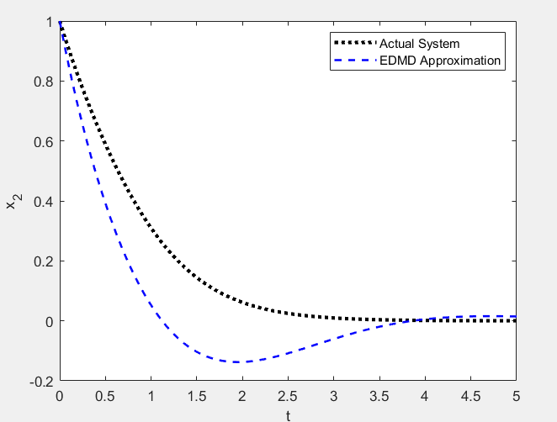
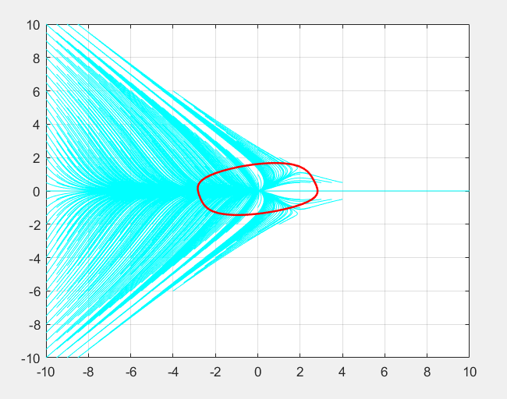
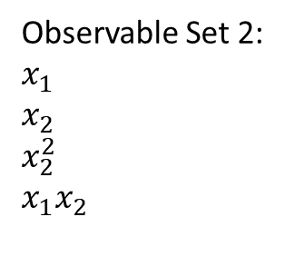
The system (“System 1”):
$${\dot{x}}_{1}=−x_{1}+x_{2}^{2}$$
$${\dot{x}}_{2}=−{2x}_{2}+x_{1}x_{2}$$
Observable Set 2:
$$x_{1}$$
$$x_{2}$$
$$x_{2}^{2}$$
$$x_{1}x_{2}$$

Slide 4
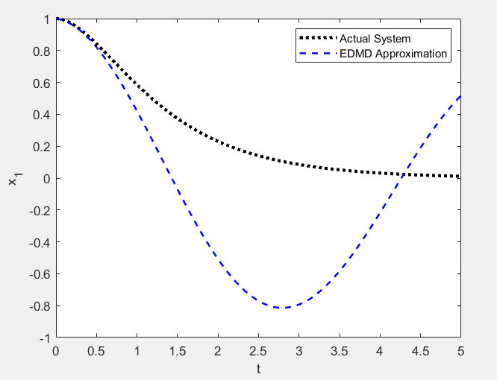
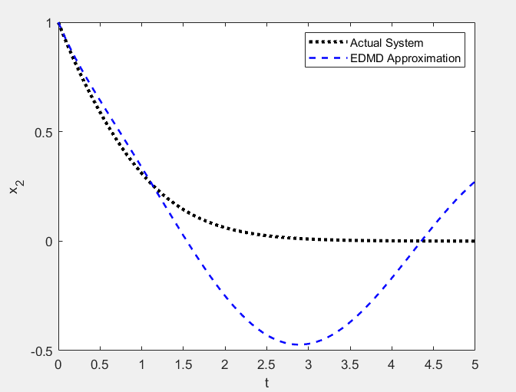
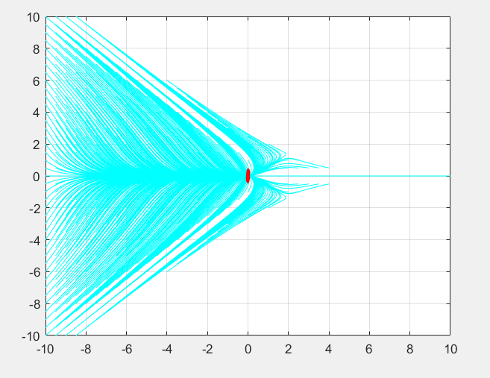
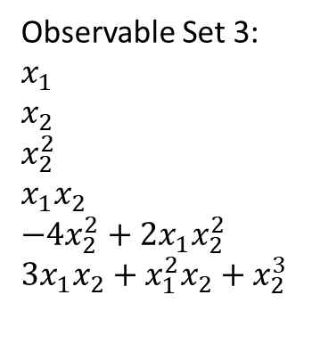
The system (“System 1”):
$${\dot{x}}_{1}=−x_{1}+x_{2}^{2}$$
$${\dot{x}}_{2}=−{2x}_{2}+x_{1}x_{2}$$
Observable Set 3:
$$x_{1}$$
$$x_{2}$$
$$x_{2}^{2}$$
$$x_{1}x_{2}$$
$$−4x_{2}^{2}+2x_{1}x_{2}^{2}$$
$$3x_{1}x_{2}+x_{1}^{2}x_{2}+x_{2}^{3}$$

Slide 5
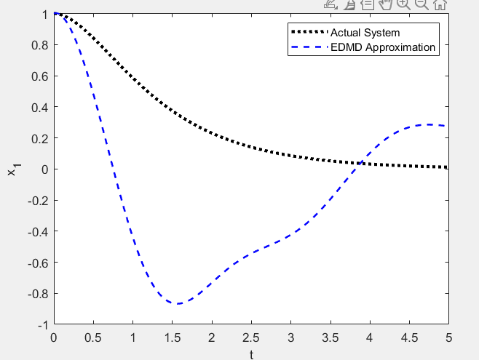
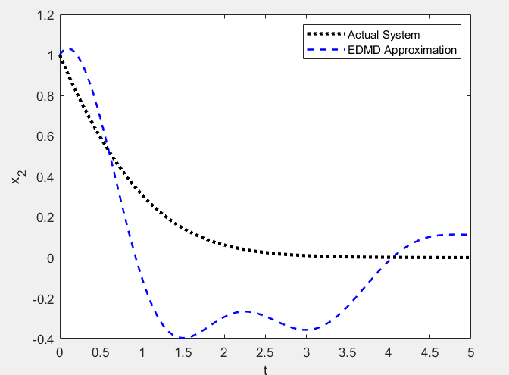
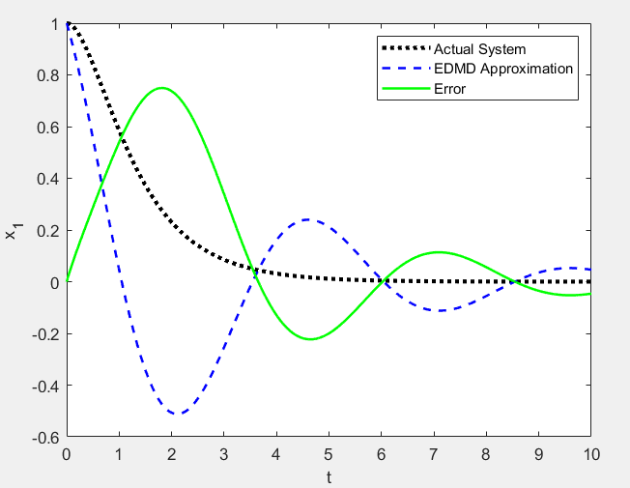
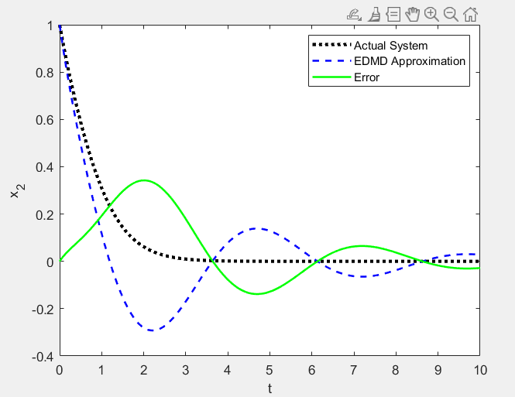
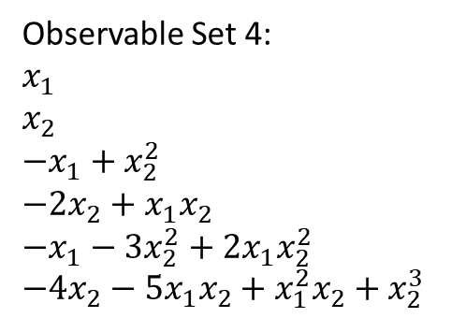
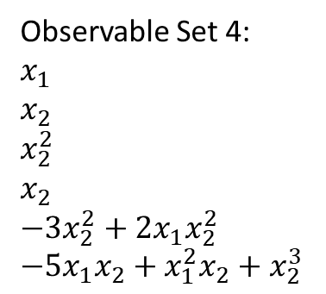
The system (“System 1”):
$${\dot{x}}_{1}=−x_{1}+x_{2}^{2}$$
$${\dot{x}}_{2}=−{2x}_{2}+x_{1}x_{2}$$
Observable Set 4:
$$x_{1}$$
$$x_{2}$$
$${−x}_{1}+x_{2}^{2}$$
$$−2x_{2}+x_{1}x_{2}$$
$$−x_{1}−3x_{2}^{2}+2x_{1}x_{2}^{2}$$
$$−4x_{2}−5x_{1}x_{2}+x_{1}^{2}x_{2}+x_{2}^{3}$$
Observable Set 4:
$$x_{1}$$
$$x_{2}$$
$$x_{2}^{2}$$
$$x_{2}$$
$$−3x_{2}^{2}+2x_{1}x_{2}^{2}$$
$$−5x_{1}x_{2}+x_{1}^{2}x_{2}+x_{2}^{3}$$

Slide 6
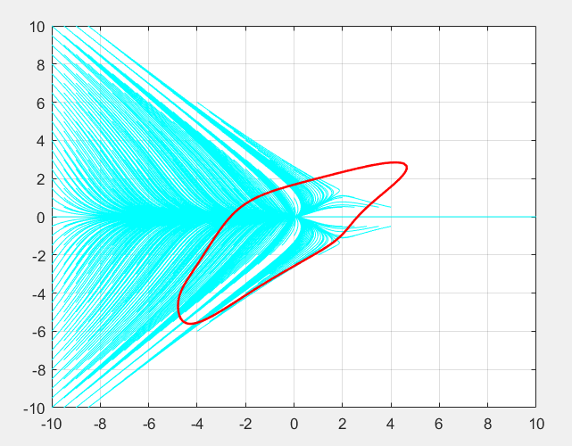
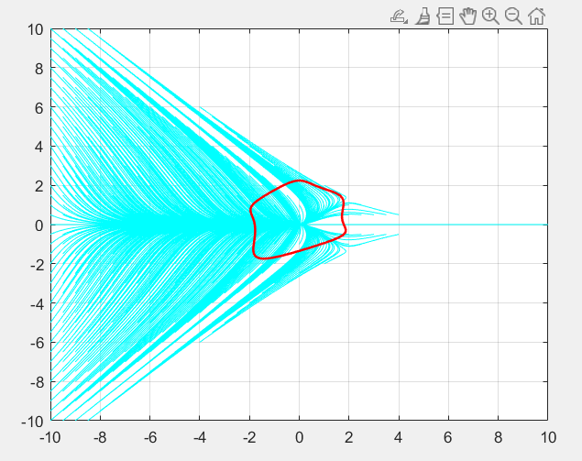

Slide 7
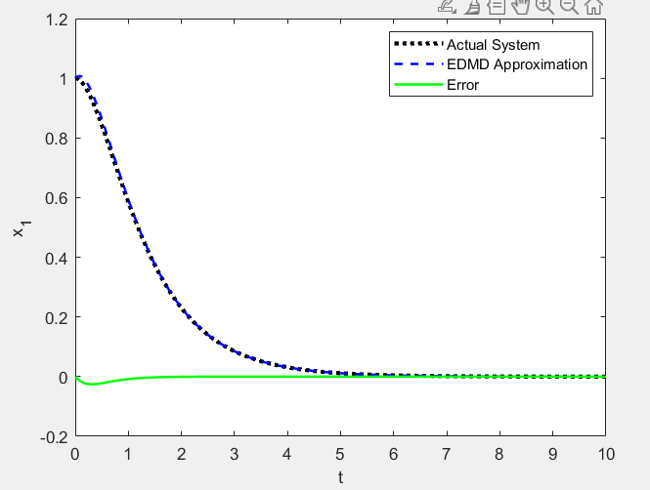
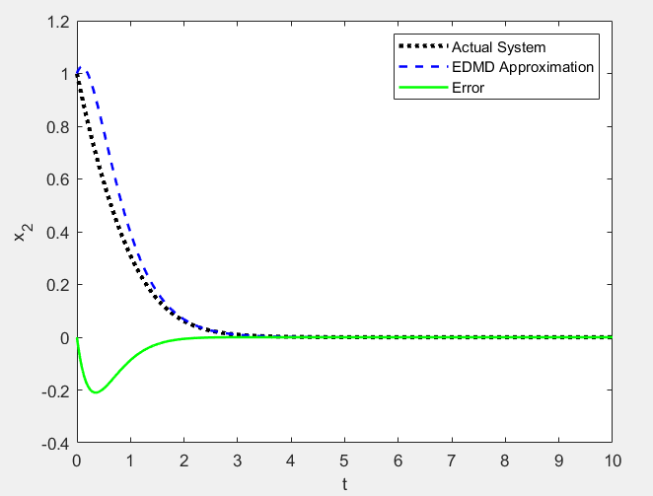
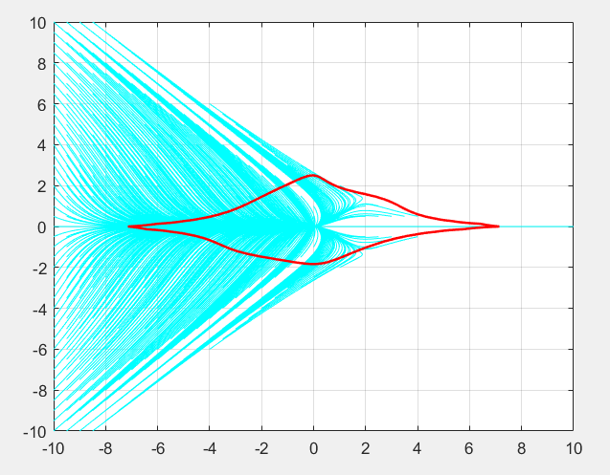
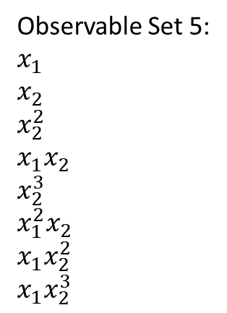
The system (“System 1”):
$${\dot{x}}_{1}=−x_{1}+x_{2}^{2}$$
$${\dot{x}}_{2}=−{2x}_{2}+x_{1}x_{2}$$
Observable Set 5:
$$x_{1}$$
$$x_{2}$$
$$x_{2}^{2}$$
$$x_{1}x_{2}$$
$$x_{2}^{3}$$
$$x_{1}^{2}x_{2}$$
$$x_{1}x_{2}^{2}$$
$$x_{1}x_{2}^{3}$$

Slide 8
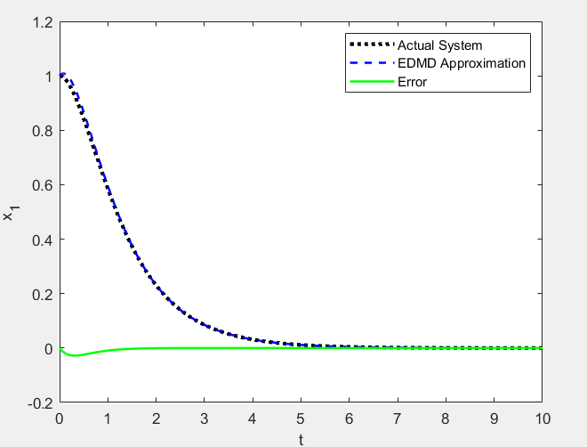
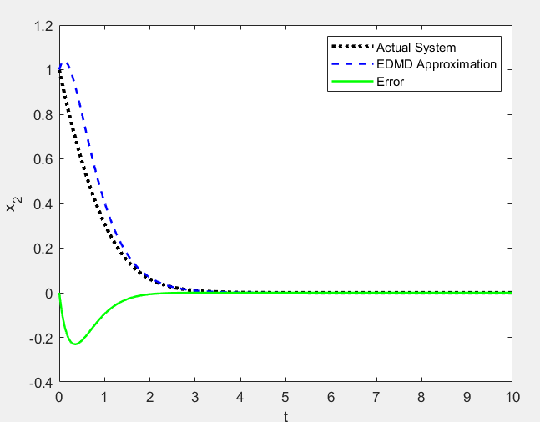
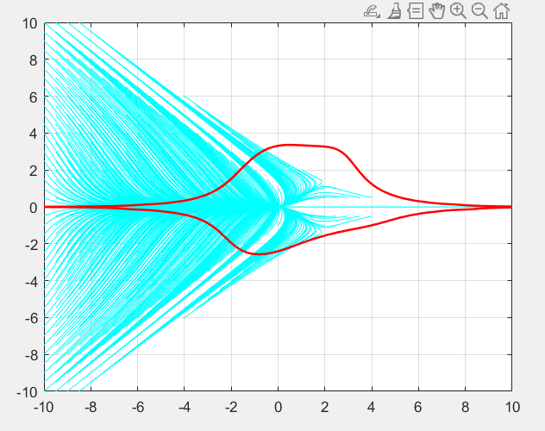
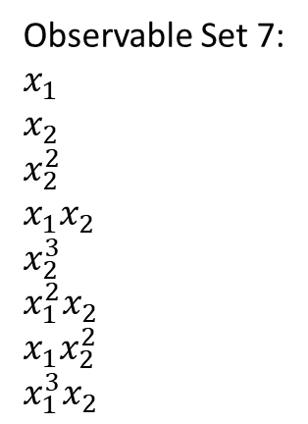
The system (“System 1”):
$${\dot{x}}_{1}=−x_{1}+x_{2}^{2}$$
$${\dot{x}}_{2}=−{2x}_{2}+x_{1}x_{2}$$
Observable Set 7:
$$x_{1}$$
$$x_{2}$$
$$x_{2}^{2}$$
$$x_{1}x_{2}$$
$$x_{2}^{3}$$
$$x_{1}^{2}x_{2}$$
$$x_{1}x_{2}^{2}$$
$$x_{1}^{3}x_{2}$$

Slide 9
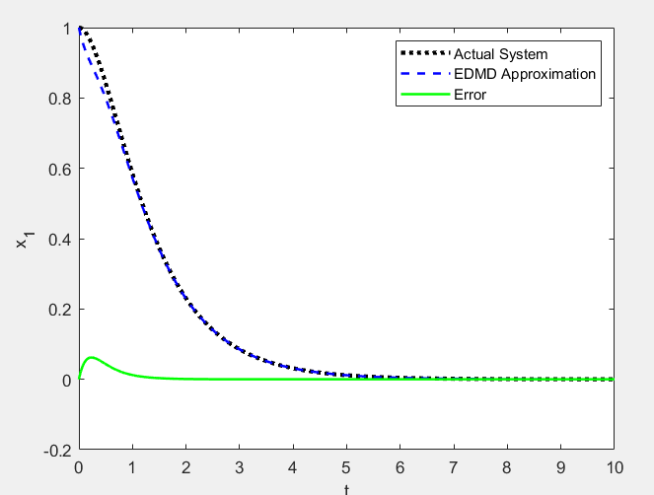
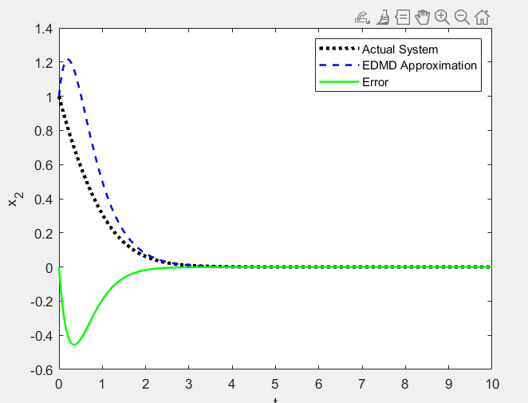
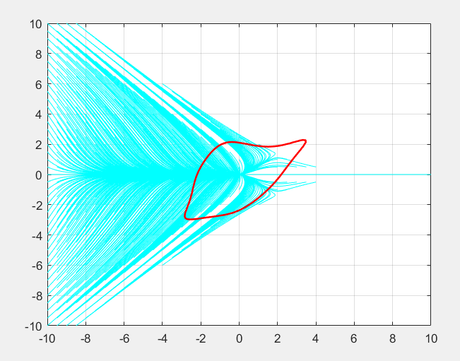
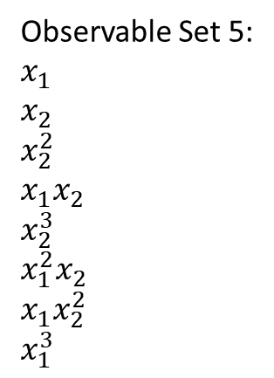
The system (“System 1”):
$${\dot{x}}_{1}=−x_{1}+x_{2}^{2}$$
$${\dot{x}}_{2}=−{2x}_{2}+x_{1}x_{2}$$
Observable Set 5:
$$x_{1}$$
$$x_{2}$$
$$x_{2}^{2}$$
$$x_{1}x_{2}$$
$$x_{2}^{3}$$
$$x_{1}^{2}x_{2}$$
$$x_{1}x_{2}^{2}$$
$$x_{1}^{3}$$

Slide 10
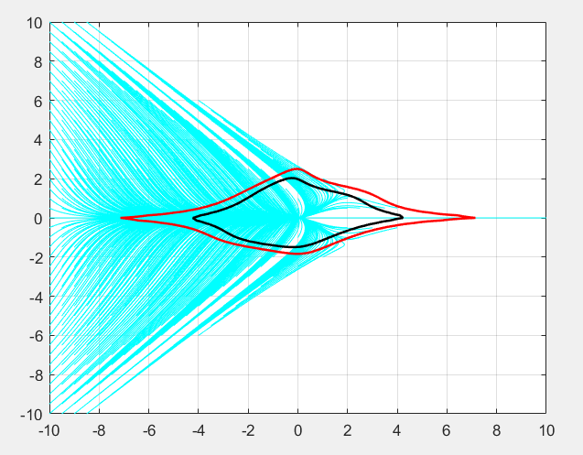
Max_c method versus r method
Red- max_c
Black - r

